Slide 1
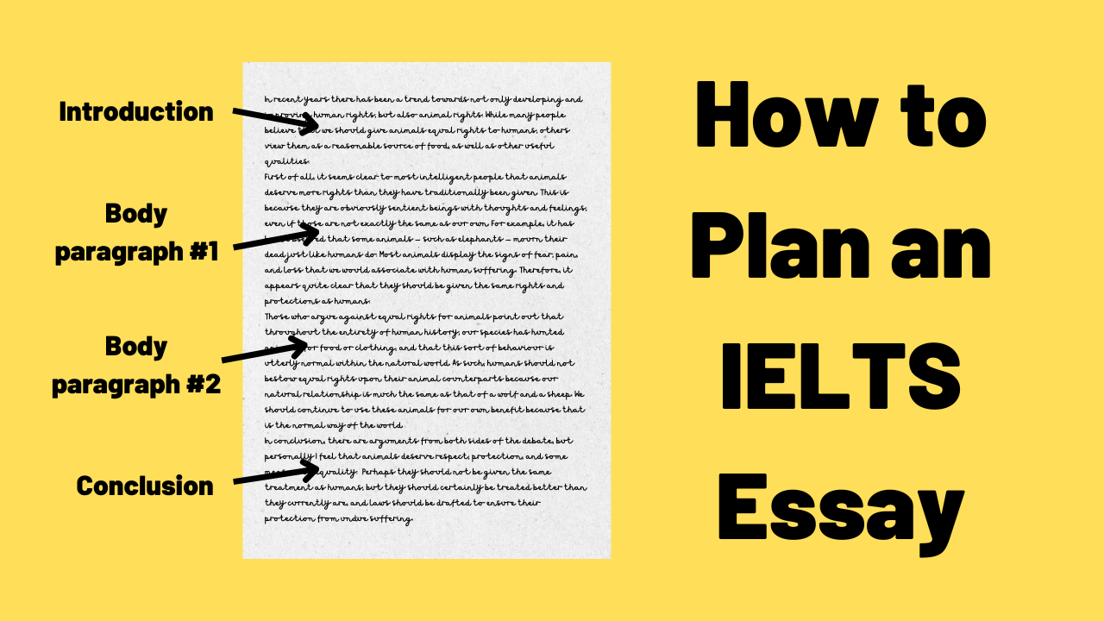

Slide 2
Reasons Why You Must Plan Your IELTS Essay
Planning saves you time
If you plan your essay before you start writing, you will already know what you are going to say and won’t need to keep stopping to think about the next idea. This means that you will be able to write much faster than if you don’t have a plan.
You only need to spend 5 minutes in the planning stage. That leaves a full 35 minutes to write and check your essay.

Slide 3
Reasons Why You Must Plan Your IELTS Essay
Planning results in a more relevant answer
Remember, 25% of your marks are for task achievement. This includes,
Answering all parts of the question
Presenting relevant ideas that are well-developed
Having clear supporting points to extend the main idea
A common mistake in IELTS essay writing is the failure to answer all parts of the question.
Part of the planning process involves thinking up ideas to include in your essay. Taking the time to analyse the question and focus on generating a few key ideas with relevant examples will ensure that you answer the question fully.

Slide 4
Reasons Why You Must Plan Your IELTS Essay
Planning results in a better structure
Another 25% of the marks are for coherence and cohesion. This includes,
Organizing your ideas into a logical order
Having a separate paragraph for each main idea
Linking your paragraphs appropriately
You can have the best ideas in the world, but unless you can develop them into a well-structured essay, you will not score highly for coherence and cohesion.
The examiner needs to be able to understand what you are saying and see a clear progression of relevant ideas. Without a plan, this is difficult to achieve.

Slide 5
Common Mistakes
1. They don’t spend time carefully reading and analysing the question.
2. They fail to recognise the type of question being asked.
3. They don’t fully understand the question.
4. They write about the general topic rather than answering the specific question.

Slide 6
Simple Steps of IELTS Essay Planning
Analyse the question
Generate ideas
Record synonyms
Plan the structure

Slide 7
Analysing
# 1 Topic words
# 2 Other keywords
# 3 Instruction words

Slide 8
Sample question:
In some poorer areas of large cities people are too afraid to leave their houses at night time due to a fear of crime.
What are the causes of crime in those areas and what can be done to tackle those problems?
Topic words
The topics words (in blue) are the ones that identify the general subject of the question.
So, this question is about ‘fear of crime’. We now need to know what aspect of ‘fear of crime’ we are required to write about. For this information, we look at the other key words.

Slide 9
In some poorer areas of large cities people are too afraid to leave their houses at night time due to a fear of crime.
What are the causes of crime in those areas and what can be done to tackle those problems?
Other Keywords
The other keywords (in red) in the question tell you the specific topic you must write about. They define the opinion stated in the statement.
Here they are, isolated from the statement:
large cities
poor areas
afraid to leave their houses
night time
These are the only aspects of ‘fear of crime’ that you should write about. Do not write about ‘crime’ or ‘fear of crime’ in general or you will be given a low mark for task achievement.

Slide 10
Instruction words
The instruction words are all the words that come after the question statement. They tell you exactly what the examiner wants you to do. For example,
What are the causes of crime in those areas and what can be done to tackle those problems?
25% of your marks are determined by how well you answer the question.
Our sample question is a ‘causes and solutions’ question. It requires you to give clear ideas on both the causes of crime in poor areas of large cities and some possible solutions.
A common mistake is to write about just one side of the issue, e.g. just the causes, or to not fully develop both sides, resulting in an unbalanced essay.

Slide 11
Task 1 Planning
You are required to write a short report about the main features. For example, you may be asked to:
· summarise data
· describe the stages of a process
· explain how something works
· describe an object or event
The format of the question will always be the same. It will include:
· A brief description of the graphic
· The instructions
· The graphic – chart, graph, table, etc.

Slide 12
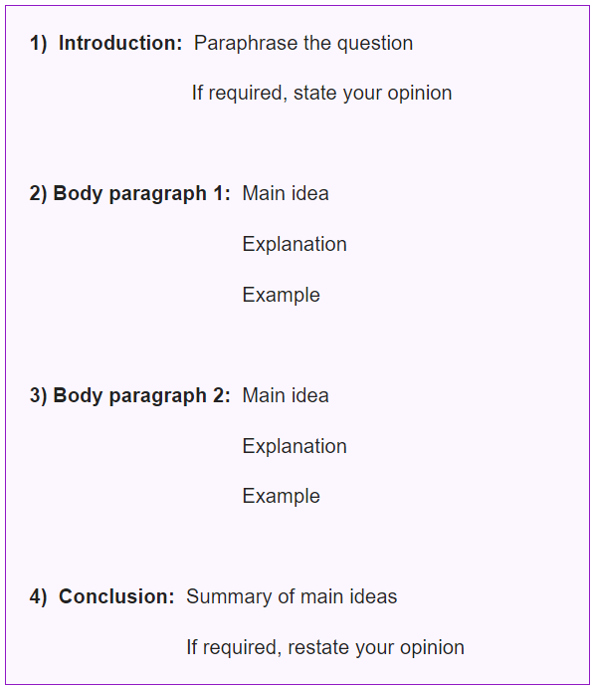
How to Structure Your Essay Task-2

